Slide 1
Azure Web Apps
Binod Jung Bogati
[Binod.Bogati@studentpartner.com]

Slide 2





Azure App Service Family
Web Apps
Web apps that scale with your business
Mobile Apps
Build mobile apps for any device
Logic Apps
Automate business processes across SaaS and on-premises
API Apps
Build and consume APIs in the cloud
Notes:
Azure App Service is a PaaS offering that comprises four separate (but related) services:
Web Apps is a fully managed compute platform optimized to host Web sites and Web applications
Mobile Apps provides infrastructure for hosting back-ends for mobile apps -- for example, it provides infrastructure for sending push notifications not only to Windows clients, but to iOS and Android clients as well
API Apps makes it easy to host APIs in the cloud, features integrated support for Swagger (http://swagger.io/), and offers a built-in authentication service for restricting access to APIs
Logic Apps allows you to automate business processes and workflow -- for example, automatically finding negative tweets about your company and sending notifications to a Slack channel
Together, these services comprise a ready-made solution to many of the challenges involved in publishing Web sites, Web apps, Web services, mobile apps, and more.

Slide 3


Azure Web Apps
Support a variety of languages and platforms
.NET, Java, Node.js, PHP, Python, and more
Support scaling (manual or auto) and load balancing
Support slots for staged deployments and A/B testing
Support continuous integration
Familiar and Fast
Leverage existing skills, plus languages, frameworks, and tools you're familiar with
Enterprise Grade
ISO-, SOC2-, and PCO-compliant with enterprise-level SLAs
Global Scale
Scale up and down as needed, manually or automatically
Notes:
The focus of this presentation is Azure Web Apps (https://azure.microsoft.com/en-us/documentation/articles/app-service-web-overview/). This service supports multiple languages and frameworks, including ASP.NET, Node.js, Java, PHP, and Python, so you can "use what you know" to begin leveraging it quickly. It supports scaling (manually or automatically) so capacity can grow as demand grows. It supports deployment slots for staged deployments -- for example, publish to staging, test your changes there, and then swap it into production only after you're confident it is ready. And it supports continuous integration, enabling you to be agile and aggressive in fixing bugs, adding features, and doing everything else needed to keep your site fresh and up to date.

Slide 4
Scaling Up vs. Scaling Out
Scale Up
Scale Out
Vary the VM size
Vary the VM count
1 Core w/ 1.75 GB RAM 2 Cores w/ 3.5 GB RAM 4 Cores w/ 7 GB RAM
Max 3* instances Max 10 instances Max 20/50** instances
Notes:
With a traditional server farm, there are two ways to scale to meet demand:
Scale up by beefing up the servers (more RAM, more cores, etc.)
Scale out by adding servers
The same holds true for virtual server farms. In App Services, scale up is a choice between B/S/P 1-3, where 1 = 1 Core, 1/75 GB RAM, 2 = 2 Core, 3.5 GB RAM, 3 = 4 Core, 7 GB RAM. You can also scale up/down between tiers (B/S/P), which impacts local HDD storage (10/50/250 GB) as well as the cap on number of instances (3/10/50).
* For 3 instances on Basic, only manual scaling is supported
** For Premium Tier, there is a max of 20 if not using ASEs, and 50 if using ASE’s

Slide 5
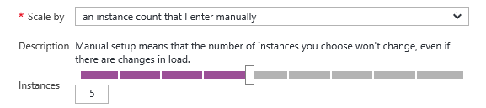
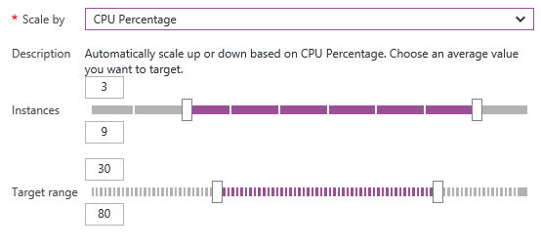
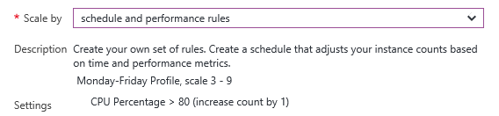
Manual Scaling vs. Auto-Scaling
Manual – Scale via portal or scripts
Auto – CPU Percentage
Auto – Schedule & Performance Rules
Notes:
Manual scaling can be as simple as moving a slider to increase the number of VM instances. Auto-scaling can be enacted by scaling the number of VM instances as CPU utilization increases, or through rules that you specify. An example of the latter is scaling up during certain hours of the day in which you anticipate peak demand.

Slide 6

Web App
Notes:
Demonstrate scaling out in this and the next two slides by showing the VM count increasing as traffic increases.

Slide 7
Web App

Slide 8
Web App

Slide 9
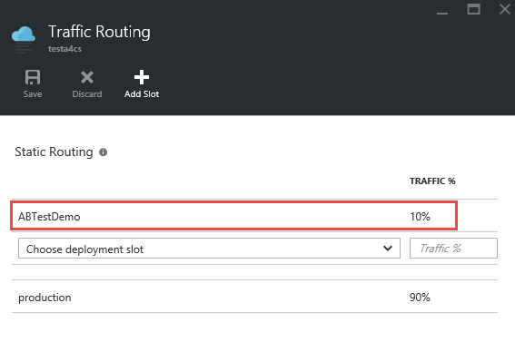
A/B Testing
Test changes by routing requests to different deployment slots
Use Traffic Routing to direct % of traffic to alternate slots
Notes:
A/B testing is useful for determining which of two landing pages, for example, is more effective in engaging customers. With Azure Web Apps, you can easily route traffic to different deployment slots by specifying percentage-based traffic allocations in the portal.

Slide 10






Continuous Integration
Web apps can be deployed manually via FTP or WebDeploy
Automate deployment using 3rd party source-control providers
Can also use a local Git repository from Azure Portal
Git
Visual Studio Team Services
CodePlex
GitHub
BitBucket
DropBox
Notes:
Continuous integration means deploying updates to your Web app as often as needed -- even several times a day. Azure supports many different deployment methods, including FTP, Git deployment (publishing from a local Git repository to Azure), and WebDeploy, which supports diff-deployment, database creation, and more. Visual Studio has integrated support for all three. Teams can also publish via third-party source-control providers such as Kudu (https://github.com/projectkudu/kudu/wiki/Deployment), which supports deployments from OneDrive and Dropbox, as well as repository-based deployments from GitHub, BitBucket, VSTS, and local Git repositories. For more information, see https://azure.microsoft.com/en-us/documentation/articles/web-sites-deploy/.

Slide 11
App Service Plans
Billing and provisioning for App Service resources
 | Free | Shared | Basic | Standard | Premium
# of Apps | 10 | 100 | Unlimited | Unlimited | Unlimited
Shared Disk Space | 1 GB | 1 GB | 10 GB | 50 GB | 500 GB
Maximum Instances | 1 | 1 | 3 | 10 | 50
Autoscale | No | No | No | Yes | Yes
Staging Environments |  |  |  | 5 | 20
Custom Domains | No | Yes | Yes | Yes | Yes
SLA |  |  | 99.95%
Notes:
When you create an Azure Web App, you are asked to choose an App Service plan (or create a new one). These plans support 5 pricing tiers (Free, Shared, Basic, Standard, and Premium), with each tier offering a unique combination of capabilities and capacity. Apps in the same subscription and geographic location can share a plan. For more information, see https://azure.microsoft.com/en-us/documentation/articles/azure-web-sites-web-hosting-plans-in-depth-overview/.

Slide 12
Demo

